Slide 1

Jeremy van Gorp
232189
NPEC
[photo]
Learning Log
Year 2
Block B
https://github.com/JeremyvanGorp232189/2025_B/blob/7803f10b1322ef26ca39e440f8022265395d48c8/Y2B_worklog_24-25_ADSAI%20(1).xlsx
https://github.com/JeremyvanGorp232189/2025_B/blob/7803f10b1322ef26ca39e440f8022265395d48c8/Y2B_self-assessment-rubric_24-25_ADSAI%20(1).xlsx
https://github.com/JeremyvanGorp232189/2025_B.git

Slide 2

How To Use
This Template
As a student at Breda University of Applied Sciences studying to become a professional, you are required to provide evidence that demonstrates your professional learning and growth during the block. This template is intended to provide you with a well-structured and organised format for doing this effectively. Keep in mind that certain competencies may require you to update your evidence every week, and others may have only be relevant during a particular week or two.
With the evidence you present here teachers should get a clear and comprehensive overview of your progress, how you’ve engaged with feedback, as well as your general attitude and performance as a student and as an aspiring professional developer.
Note that number and size of text boxes and how they are organized on each slide may be modified as needed. It is up to you to decide what layout is most effective for the content you are providing. You may also add slides if needed, but try to be as economical as possible, i.e. quality over quantity. Focus on the things that are the most significant and meaningful.
You are also free to stylise this template to improve the graphic design and visual appeal, but please remember its purpose: to provide evidence of your progress towards becoming a professional developer. Changes should only enhance and extend the information, and may never subtract. I.e. do not delete anything or change the order of things. If in doubt, seek approval from your teachers!

Slide 3
Learning Log
Structure
Section A - My Plan Must be completed in week 1
Your plan describes your goals for the block. Starting with where you are right now, where do you want to be at the end of the block? I.e. what role(s) will you take responsibility for, and how will you demonstrate progress relevant to the ILOs for this block? What tasks and deliverables are best aligned with your role and the project brief?
Section B - ILO’s Must be completed in week 8, but should be updated regularly
This is where you link your evidence to each of the Intended Learning Outcomes of this block.
Section C - Weekly Log Must be updated every week
This is simply a log (journal) of what you do each day, and what you learn from it. It is your responsibility to update this regularly and frequently. Be sure to include working links to any specific evidence you are referencing (and make sure that you share your docs with the teaching team). Note: some of the required information may be captured in production documents such as your work log or peer reviews.
In such cases, you simply need to provide links to those artifacts and may include any explanatory comment or reflection you feel is appropriate.
(Some reflection is almost always a good idea as it provides the foundation for Section C.)
Section D - Reflection Must be completed in week 8
Summative reflection on your progress during the block including a critical assessment of everything you did and learned during the block. This is a comprehensive review of everything recorded in Section B, evaluated against the goals and planning laid out in Section A.
Section A
Starting this block
Goals
Section B
ILO section
Week log section
Section C
Block reflection

Slide 4
Section A
In the first week, the student sets ambitious, S.M.A.R.T. goals in alignment with the project brief, their chosen role(s), content of the assessment rubric and their personal long-term goals
A
Goal Setting
Notes:
MUST BE UPDATED EVERY WEEK
This is simply a log (journal) of what you do each day, and what you learn from it. It is your responsibility to update this regularly and frequently. Be sure to include working links to any specific evidence you are referencing (and make sure that you share your docs with the teaching team). Note: some of the required information may be captured in production documents such as your work log or peer reviews.
In such cases, you simply need to provide links to those artifacts and may include any explanatory comment or reflection you feel is appropriate.
(Some reflection is almost always a good idea as it provides the foundation for Section C.)

Slide 5
A
Where am I starting?
1/2
Feedback from previous assessment -
Make sure that the work aligns with the project expectations to avoid missing key points. Additionally, ensure that your work is well-documented, clearly structured, and meets the outlined rubric criteria. Consider breaking tasks into smaller milestones to stay organized and on track.
My interpretation / key takeaways
Sometimes during the block, it’s necessary to cut losses and focus on progress, even if it means retaking certain tasks in the next block. However, the goal is to stay ahead of the workload by managing time effectively and planning ahead. If I encounter challenges or uncertainty, I will proactively ask for help to ensure I stay aligned with the project expectations.
Notes:
Copy and paste the feedback from the previous block’s assessment into the text box.
Copy and paste the bullet points you listed on the “Lessons Learned” page in section C of your last block’s log.
Compare the grade you gave yourself with the grade you received, and reevaluate or restate your feeling on your current level of progress.

Slide 6
A
What is my plan?
2/2
What I learned last block - Previous block’s grade
6.3
I learned about scientific writing and using data from polls to analyze both qualitative and quantitative aspects. I also gained experience in structuring research papers effectively, understanding the importance of critical analysis, and incorporating reliable sources to support arguments. Additionally, I improved my skills in data visualization, presenting findings clearly and concisely to different audiences.
My current level of progress
I now know how to structure a scientific paper and have gained more knowledge about cybersecurity. I also feel more comfortable in the field of data science, including applying machine learning techniques and working with larger datasets. Furthermore, I have improved my skills in Python and tools such as Jupyter Notebook and Power BI, which help me better communicate data insights. I feel more confident in my ability to solve complex problems by combining analytical thinking and practical skills.
Links
https://github.com/BredaUniversityADSAI/2024-25a-fai2-adsai-JeremyvanGorp232189.git
Notes:
Copy and paste the feedback from the previous block’s assessment into the text box.
Copy and paste the bullet points you listed on the “Lessons Learned” page in section C of your last block’s log.
Compare the grade you gave yourself with the grade you received, and reevaluate or restate your feeling on your current level of progress.

Slide 7
A
What are my goals?
1/1
S | Specific: Be specific when determining your goal. The more specific the better. Putting a real figure to your goal helps make it measurable. When specific and measurable your subconscious mind cannot override your goals, they become achievable.
M | Measurable: This where you define a measurable and meaningful goal. It’s important to be able to track your progress. Without meaningful and measurable goals which you can track it’s easy to lose heart and focus.
A | Achievable: Choosing realistic and short-term goals helps them be more achievable. Long-term goals can be larger and take more time to achieve. Planning smaller short-term goals as steps to larger long-term goals assists in achieving them.
R | Relevant: Each goal you set must be in line with your core values and in harmony with what YOU want out of life. Contradictions in values and goals leads to frustration and loss of motivation. Designing your goals with the expectation of your personal success.
T | Time-Bound: Setting a time limit on achieving a goal makes it measurable. When a goal is measurable you can SEE your progress and support your motivation and commitment. Giving your goal a time limit assists you in holding yourself accountable to its completion.
E | Evaluate: By evaluating your goals on a regular basis you will be much more likely to achieve them. It is easy to forget about long-term goals if they are not revisited from time to time. This also helps you assess if the goal you are working on remains in line with your core values and helps you measure your progress.
R | Readjust: Readjustments occur when goals are determined, through re-evaluation, to be misaligned with your values or long-term goals. This is especially helpful when you have been unable to achieve a goal in the time limits you set. This gives you the opportunity to modify your approach and increase your chances of success.
I am taking responsibility for (if multiple add in percentages)
Professional Development Goals
- Specific: I aim to enhance my understanding of U-Net segmentation by completing a course focused on building and optimizing models with image segmentation tasks.
- Measurable: I will dedicate 1-3 hours every weekend from Week 4 to Week 6, aiming to complete at least 75% of the course content by the end of Week 6.
- Achievable: This goal is realistic and achievable, as I can set aside 1-3 hours each weekend specifically for the course without disrupting my other commitments.
- Relevant: This goal aligns directly with my current work and learning objectives, as U-Net segmentation is a critical component of my projects and plays a key role in image analysis tasks.
- Time-Bound: The course will be completed within the four weeks spanning Week 3 to Week 6.
- Evaluate: I will monitor my progress on the worklog to ensure I complete at least 75% of the course content at week 6, while also assessing my understanding by applying the techniques in practical exercises.
- Readjust: If I fall behind, I will dedicate an additional 1-2 hours during weekdays to catch up, ensuring consistent progress toward completing the goal.
Notes:
Describe your goals for this block using the SMARTER method. Make sure they are clear, relevant, have a measurable outcome, and can be recorded. Consider how well do they align with the role(s) you wish to take, and with the requirements given in the project brief. Think about the objectives you plan to choose, or that are mandated by the project. Are there any competencies that you need to focus on?
For each goal, find concrete examples of tasks you expect to undertake that will demonstrate this within the project for the block. Make sure the plan has an outcome that can be tracked and assessed. Make sure you have a clearly stated target for each goal. If you are unsure of how to demonstrate something, ask for help from your teachers.

Slide 8
A
What are my goals?
1/1
S | Specific: Be specific when determining your goal. The more specific the better. Putting a real figure to your goal helps make it measurable. When specific and measurable your subconscious mind cannot override your goals, they become achievable.
M | Measurable: This where you define a measurable and meaningful goal. It’s important to be able to track your progress. Without meaningful and measurable goals which you can track it’s easy to lose heart and focus.
A | Achievable: Choosing realistic and short-term goals helps them be more achievable. Long-term goals can be larger and take more time to achieve. Planning smaller short-term goals as steps to larger long-term goals assists in achieving them.
R | Relevant: Each goal you set must be in line with your core values and in harmony with what YOU want out of life. Contradictions in values and goals leads to frustration and loss of motivation. Designing your goals with the expectation of your personal success.
T | Time-Bound: Setting a time limit on achieving a goal makes it measurable. When a goal is measurable you can SEE your progress and support your motivation and commitment. Giving your goal a time limit assists you in holding yourself accountable to its completion.
E | Evaluate: By evaluating your goals on a regular basis you will be much more likely to achieve them. It is easy to forget about long-term goals if they are not revisited from time to time. This also helps you assess if the goal you are working on remains in line with your core values and helps you measure your progress.
R | Readjust: Readjustments occur when goals are determined, through re-evaluation, to be misaligned with your values or long-term goals. This is especially helpful when you have been unable to achieve a goal in the time limits you set. This gives you the opportunity to modify your approach and increase your chances of success.
I am taking responsibility for (if multiple add in percentages)
Personal development goals
Specific: I will prepare for an ultra-marathon in September by maintaining a base mileage of 60-90 km per week, running 3-5 times per week consistently, primarily in the evenings.
Measurable: I will track my weekly mileage using a fitness app to ensure I stay within the 60-90 km range. I will also monitor my pace, recovery, and overall progress using performance metrics.
Achievable: This goal is realistic and achievable, as I am already accustomed to running regularly and have adjusted my schedule to dedicate time for these training sessions.
Relevant: This training directly supports my goal of successfully completing an ultra-marathon in September by building a solid endurance foundation during this base-building phase.
Time-Bound: I will maintain this mileage and training frequency throughout the base-building phase, which will continue until mid-March, before transitioning into more specific ultra-marathon training.
Evaluate: I will evaluate my progress weekly, ensuring my mileage is consistent and that I am maintaining proper recovery, energy levels, and performance to avoid burnout or injury.
Readjust: If I experience signs of overtraining or fatigue, I will adjust by adding extra rest days or replacing a run with low-impact cross-training, ensuring I maintain fitness while minimizing the risk of injury.
Notes:
Describe your goals for this block using the SMARTER method. Make sure they are clear, relevant, have a measurable outcome, and can be recorded. Consider how well do they align with the role(s) you wish to take, and with the requirements given in the project brief. Think about the objectives you plan to choose, or that are mandated by the project. Are there any competencies that you need to focus on?
For each goal, find concrete examples of tasks you expect to undertake that will demonstrate this within the project for the block. Make sure the plan has an outcome that can be tracked and assessed. Make sure you have a clearly stated target for each goal. If you are unsure of how to demonstrate something, ask for help from your teachers.

Slide 9
Section B
B
Progress Log
Notes:
MUST BE UPDATED EVERY WEEK
This is simply a log (journal) of what you do each day, and what you learn from it. It is your responsibility to update this regularly and frequently. Be sure to include working links to any specific evidence you are referencing (and make sure that you share your docs with the teaching team). Note: some of the required information may be captured in production documents such as your work log or peer reviews.
In such cases, you simply need to provide links to those artifacts and may include any explanatory comment or reflection you feel is appropriate.
(Some reflection is almost always a good idea as it provides the foundation for Section C.)

Slide 10
1
Week 1 - Log
1/2
What did you do?
Reflection
What goal(s) did you set for this week?
- Finish masking the pictures.
- Complete the Week 1 self-study notebooks.
- Find a course to enhance my knowledge of deep learning, specifically creating a model for binary segmentation.
What have you actually been able to do?
- I finished masking the pictures and delivered them on time.
- I completed all the notebooks.
- I couldn't find a free, good-quality course on binary segmentation yet.
Showcase the evidence of your progress (production artifacts, short descriptions-links-pictures animated gifs, etc.)
How did the week go?
- The week went alright. I made good progress on the notebooks and completed lots of pixel masking while waiting for feedback.
What went well?
- The segmentation went okay. I managed to finish on time, though I may have missed a few spots. Feedback will confirm this.
- The notebooks were completed without major issues, but I had to switch to working on my home desk laptop due to technical problems with my primary device.
What didn’t go so well?
- My laptop was behaving strangely, requiring a complete reset.
What did you learn?
- Basics of edge and contour detection, image segmentation, and other foundational concepts from the self-study notebooks.
How did your efforts in applying iterative critical thinking this week contribute to improving your approach to the project? (ILO 2.6)
See next page
- I focused on systematically addressing issues like the masking process and completing the notebooks, which helped refine my workflow and ensure timely submission.
What could be added as an Action point looking forward to next week?
- Try to restore my library

Slide 11
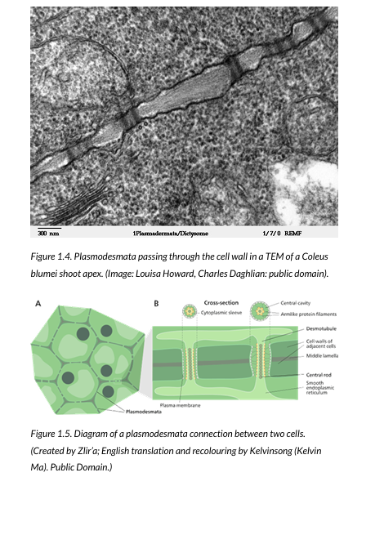
Week 1
How did your efforts in applying iterative critical thinking this week contribute to improving your approach to the project? (ILO 2.6)
My contributions have helped because...
By iteratively analyzing the anatomy and physiology of plant cells, including their structures and functions, I gained a deeper understanding of the processes occurring within the Petri dish experiments. Studying vascular tissues, cell walls, and nutrient transport systems helped me better interpret plant growth and root development. This iterative approach allowed me to connect theoretical concepts to practical observations, improving my ability to work with and analyze the plants in the Petri dish.
Website: bing.com/ck/a?!&&p=83448b82089cf8e4cf774939ad97c7b149357103d5b933ceb91f44f5d7bcebeeJmltdHM9MTczNzY3NjgwMA&ptn=3&ver=2&hsh=4&fclid=2ba299dd-f04e-66d5-2439-8ceaf13c67f3&psq=plant+science+plant+organs+pdf&u=a1aHR0cHM6Ly9jZHVlYm9va3MucHJlc3Nib29rcy5wdWIvcGxhbnRhbmF0b215L29wZW4vZG93bmxvYWQ_dHlwZT1wZGY&ntb=1

Slide 12
1
Week 1 - Feedback
2/2
Team, individual, peer, workshop feedback
232996 Joey van Angelen
Make sure to pay attention to the small details in the mask segmentations, especially the roots, as they can sometimes become very thin.
Click for feedback delivery techniques!

Slide 13
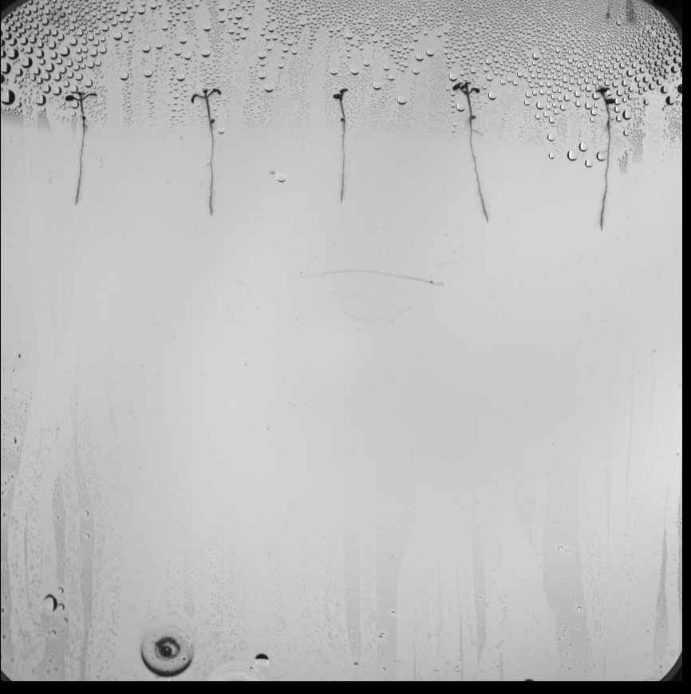
2
Week 2 - Log
1/2
What did you do?
Reflection
What goal(s) did you set for this week?
- Complete the notebooks for Week 2.
- Finish Task 2.
- Finish Task 3.
- Find a course to enhance my knowledge of deep learning, specifically creating a model for binary segmentation.
What have you actually been able to do?
- I finished Task 2.
- I am still working on Task 3.
- I found a useful course on YouTube.
- I encountered issues with my OneDrive setup.
Showcase the evidence of your progress (production artifacts, short descriptions-links-pictures animated gifs, etc.)
How did the week go?
The week was productive overall, but technical issues with OneDrive slowed me down.
What went well?
- I successfully completed Task 2 and made progress on learning about binary segmentation.
- Found a valuable learning resource on YouTube.
What didn’t go so well?
- I faced issues with my OneDrive setup, which caused delays.
- Task 3 is taking longer than expected due to some complex challenges.
What did you learn?
- I gained deeper insights into preprocessing techniques like CLAHE, Gaussian blurring, and adaptive thresholding.
I learned how to better identify and select contours in images based on aspect ratios and areas.
How did your efforts in applying iterative critical thinking this week contribute to improving your approach to the project? (ILO 2.6)
contribute to improving your approach to the project? (ILO 2.6)
- See next page
What could be added as an Action point looking forward to next week?
- Try to fix my OneDrive issue.
Task 2 output

Slide 14
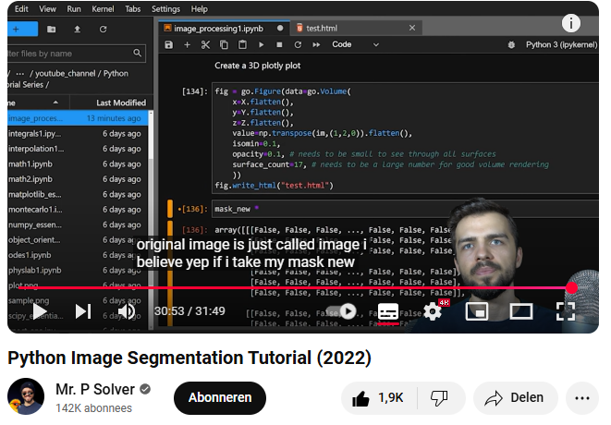
Week 2
How did your efforts in applying iterative critical thinking this week contribute to improving your approach to the project? (ILO 2.6)
My contributions have helped because...
By iteratively analyzing the video on lung segmentation, I gained insights into refining segmentation techniques, particularly for preprocessing and mask creation. This helped me better understand how to apply similar methods to Petri dish images with plants. Concepts like thresholding, region labeling, and hole filling directly improved my approach to isolating plant roots, enabling more accurate segmentation and analysis of the plant structures within the images.
Website: (1035) Python Image Segmentation Tutorial (2022) - YouTube

Slide 15
2
Week 2 - Feedback
2/2
Team, individual, peer, workshop feedback
Soma 233650
Task 2 looks fine, but make sure you don't use RGB.
Click for feedback delivery techniques!

Slide 16
3
Week 3 - Log
1/2
What did you do?
Reflection
What goal(s) did you set for this week?
Find a program to use for adding and making notes.
Finish tasks 4 through 9
Make sure to deliver the .fit masks before the deadline for second attempt.
What have you actually been able to do?
- I created a skeleton outline for tasks 4 through 9 and studied the self-learning notebooks.
Delivered on the .tif masks on time.
Showcase the evidence of your progress (production artifacts, short descriptions-links-pictures animated gifs, etc.)
How did the week go?
The week went well overall; I gathered criteria to ask the teachers. I also found a program, Obsidian, for actively taking notes.
What went well?
I am learning to use Obsidian and keeping up with the pace of the tasks. And delivered the masks on time.
What didn’t go so well?
I encountered some confusion with certain tasks. It is important to get each task right because all the tasks are connected.
What did you learn?
I learned about using U-Net and other tools, and I also learned how to use Obsidian effectively.
How did your efforts in applying iterative critical thinking this week contribute to improving your approach to the project? (ILO 2.6)
- See next page
What could be added as an Action point looking forward to next week?
- Nothing to add.

Slide 17
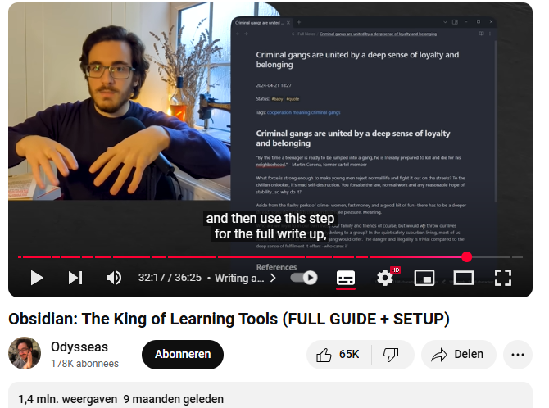
Week 3
How did your efforts in applying iterative critical thinking this week contribute to improving your approach to the project? (ILO 2.6)
My contributions have helped because...
By using Obsidian as outlined in the video, I improved the way I study and organize my self-study notebooks. The app’s features, such as tagging, linking, and concise note structuring, allowed me to create a more efficient and interconnected system for managing my notes. This iterative process helped me revisit and refine topics, ensuring a deeper understanding of the material. With Obsidian, I was able to connect ideas across different study areas, making it easier to synthesize information and build reusable insights. This approach streamlined my workflow and enhanced my ability to retain and apply knowledge effectively.
Website: (1035) Obsidian: The King of Learning Tools (FULL GUIDE + SETUP) - YouTube

Slide 18
3
Week 3 - Feedback
2/2
Team, individual, peer, workshop feedback
232996 Joey van Angelen
- Make sure to use the right crop size in task 4
Click for feedback delivery techniques!

Slide 19
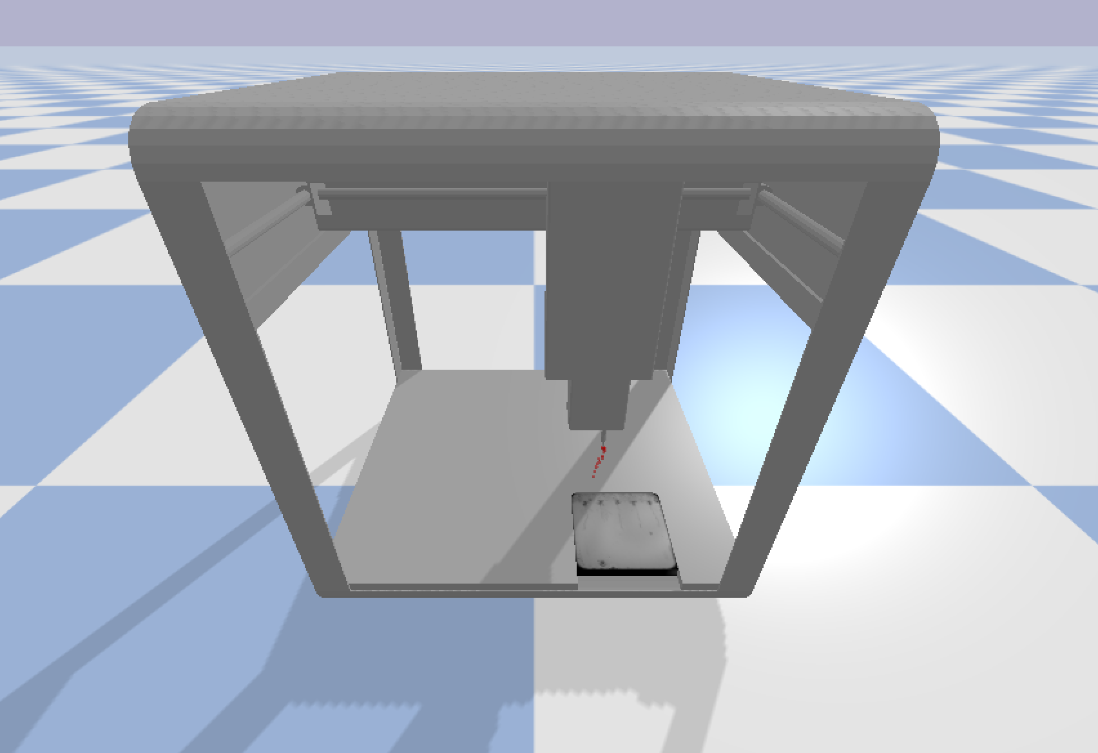
4
Week 4 - Log
1/2
What did you do?
Reflection
What goal(s) did you set for this week?
- Reworking task 4 until task 9.
- Starting with task 10.
- Installing C++ for PyBullet.
What have you actually been able to do?
I was reworking task 4 and 5. I also revisited the self-study notebooks from weeks 2-3 and made detailed notes in Obsidian.
Showcase the evidence of your progress (production artifacts, short descriptions-links-pictures animated gifs, etc.)
How did the week go?
The week went well overall. Revisiting the work allowed me to gain a better understanding of the material.
What went well?
I reworked task 4 and started task 5. I also installed the necessary packages to ensure task 10 would work successfully.
What didn’t go so well?
I thought I could work faster, but it took more time than expected as I actively took notes on the week 2-3 self-study notebooks.
What did you learn?
- I improved my understanding of root detection through task 4 and segmentation concepts from the self-study material. I also gained practical experience with the tools and techniques required to work on tasks 4, 5, and 10, including generating and validating image patches, preprocessing techniques, and installing C++ dependencies.
How did your efforts in applying iterative critical thinking this week contribute to improving your approach to the project? (ILO 2.6)
- See next page
What could be added as an Action point looking forward to next week?
Nothing to add

Slide 20
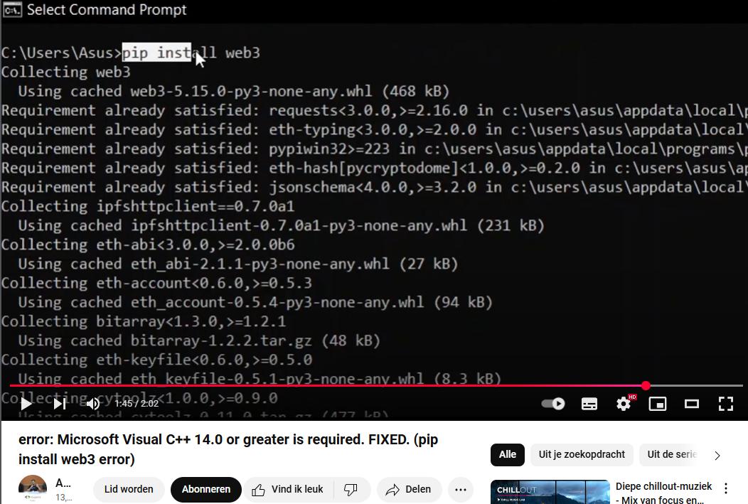
Week 4
How did your efforts in applying iterative critical thinking this week contribute to improving your approach to the project? (ILO 2.6)
My contributions have helped because...
By following the video tutorial on resolving the "Web3 Library Installation Error," I successfully applied the steps to fix my PyBullet installation issue. Installing the required Microsoft Visual C++ Build Tools resolved the errors I encountered while setting up the library. This iterative problem-solving approach allowed me to proceed with my self-study tasks efficiently, ensuring that I could focus on improving my PyBullet implementation and advancing my understanding of robotics simulations.
Website: error: Microsoft Visual C++ 14.0 or greater is required. FIXED. (pip install web3 error)

Slide 21
4
Week 4 - Feedback
2/2
Team, individual, peer, workshop feedback
Soma 233650
- For task 10 to work properly you need to download c++ packages in vscode.
Click for feedback delivery techniques!

Slide 22
5
Week 5 - Log
1/2
What did you do?
Reflection
What goal(s) did you set for this week?
- Creating a working model for task 5.
What have you actually been able to do?
I changed my model with U-net. It was not easy, but it perfomance not good yet with a F-1 score of
Showcase the evidence of your progress (production artifacts, short descriptions-links-pictures animated gifs, etc.)
How did the week go?
- The week went alright. The model performance on the server is doing okay. It was a though week with a lot of reworks.
What went well?
- I managed to finish my goal for the week.
What didn’t go so well?
- I wanted to work on other tasks which I did, but they probably need a rework in the upcoming weeks.
What did you learn?
- I learned about setting up a U-net model from scratch with the help of YouTube.
How did your efforts in applying iterative critical thinking this week contribute to improving your approach to the project? (ILO 2.6)
- See next page
What could be added as an Action point looking forward to next week?
Find a course about decoders and encoders for the U-net model

Slide 23
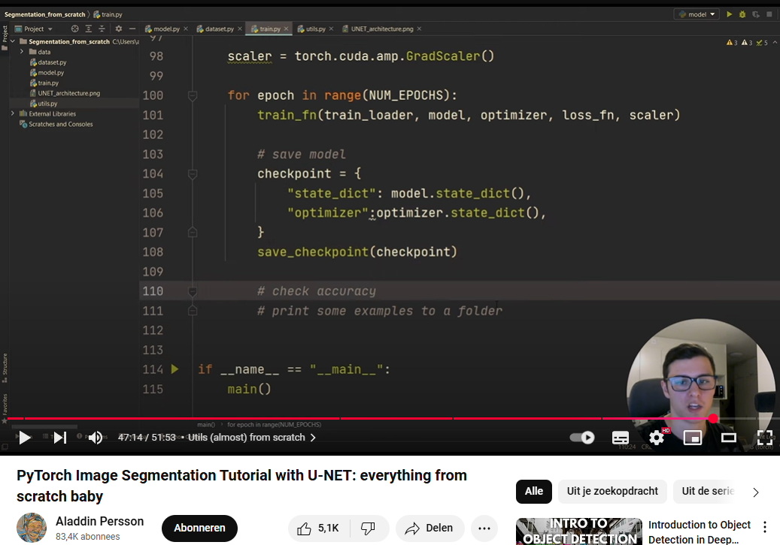
Week 5
How did your efforts in applying iterative critical thinking this week contribute to improving your approach to the project? (ILO 2.6)
My contributions have helped because...
By following the video tutorial on implementing a U-Net model in PyTorch, I successfully built my first U-Net model for image segmentation. The step-by-step guide helped me understand key components like downsampling, upsampling, data augmentation, and evaluating segmentation metrics such as the Dice coefficient. Applying these concepts, I was able to create a segmentation pipeline tailored to my project, improving my understanding of deep learning architectures and their practical application in computer vision tasks.
Website: (1037) PyTorch Image Segmentation Tutorial with U-NET: everything from scratch baby - YouTube

Slide 24
5
Week 5 - Feedback
2/2
Team, individual, peer, workshop feedback
Soma 233650
- Make sure to use a larger data-set while using your U-net model.
Click for feedback delivery techniques!

Slide 25
6
Week 6 - Log
1/2
What did you do?
Reflection
What goal(s) did you set for this week?
Making sure that task 5 works with the root prediction.
Make a planning for next week to finish task 11 til 15.
What have you actually been able to do?
I have managed to continue work on self-study material such as skeleton analysis.
I made a planning to work on the unfinished tasks.
Study and finish the Udemy Course about decoding and encoding for the U-net model.
Showcase the evidence of your progress (production artifacts, short descriptions-links-pictures animated gifs, etc.)
How did the week go?
Unfortunately, the servers were down, that is why I moved task 6 and 7 to week 7 on Monday. And I was sick for the first 2 days of the week.
What went well?
I improved the code of task 5 and made overall good practice with my progression. And finished the course on Udemy.
What didn’t go so well?
The servers were down, so I could not test a few models I had created.
What did you learn?
Next to the tasks I learned more about robotics by learning more about PyBullet and including reinforcement learning.
How did your efforts in applying iterative critical thinking this week contribute to improving your approach to the project? (ILO 2.6)
- See next page
What could be added as an Action point looking forward to next week?
- At all costs, finish the kaggle competition next week before the deadline with a decent score.

Slide 26

Week 6
How did your efforts in applying iterative critical thinking this week contribute to improving your approach to the project? (ILO 2.6)
My contributions have helped because...
This course helped me design and understand the U-Net model for image segmentation, which I successfully applied to plant science projects. By learning how to implement U-Net, optimize hyperparameters, and evaluate metrics like IOU, precision, and F-score, I was able to build a model specifically tailored for segmenting plant roots. The focus on encoder and decoder architectures, data augmentation, and practical examples provided me with the tools to handle complex segmentation tasks in plant science. Additionally, understanding techniques like transfer learning and pretrained models improved the accuracy and reliability of my results. This course greatly enhanced my ability to apply deep learning to analyze plant structures effectively, supporting my research and data analysis in plant science.
Website: Deep Learning for Image Segmentation with Python & Pytorch | Udemy

Slide 27
6
Week 6 - Feedback
2/2
Team, individual, peer, workshop feedback
232996 Joey van Angelen
Tip, use a debugging strategy to your kaggle notebook.
Click for feedback delivery techniques!

Slide 28
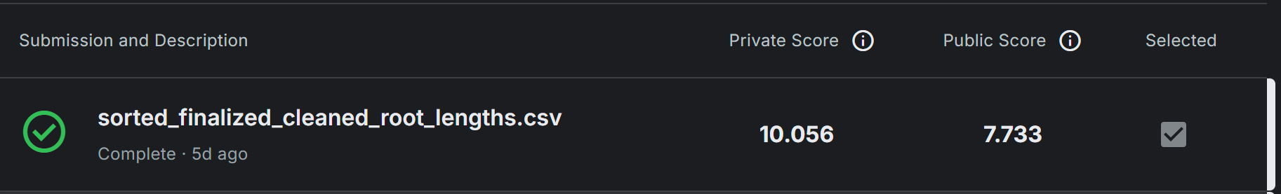
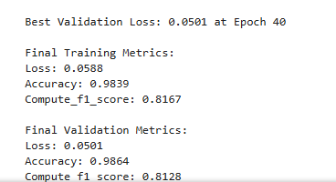
7
Week 7 - Log
1/2
What did you do?
Reflection
What goal(s) did you set for this week?
Finish the kaggle competition and score below 15.
U-net model with a F-1 score greater than 0.8.
What have you actually been able to do?
Both of the goals set for this week have been completed.
Showcase the evidence of your progress (production artifacts, short descriptions-links-pictures animated gifs, etc.)
How did the week go?
This week was one of the longest week working on school. A high-pressure week with an important deadline,
What went well?
I managed to meet the goals that were set for this week and worked hard to het there.
What didn’t go so well?
Time management was horrible this week. I worked around 40 hours on school. I worked an additional 40 hours at my two part-time jobs. No free time!
What did you learn?
I learned more about the world of U-net and segmentation. Better technique in decoding, encoding and overall structure.
How did your efforts in applying iterative critical thinking this week contribute to improving your approach to the project? (ILO 2.6)
- See next page
What could be added as an Action point looking forward to next week?
- Make a planning to manage my time.

Slide 29
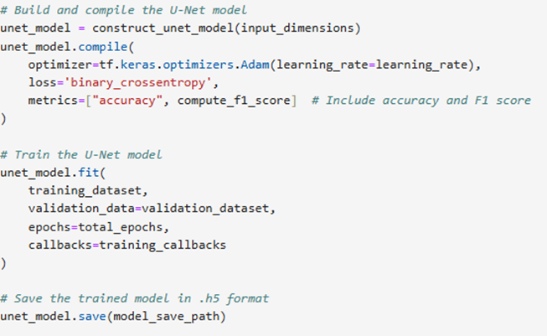
Week 7
How did your efforts in applying iterative critical thinking this week contribute to improving your approach to the project? (ILO 2.6)
My contributions have helped because...
This code helped me improve my U-Net model by allowing me to evaluate and overwrite the old model if better F1 scores or accuracy were achieved. By compiling the model with metrics such as F1 score and accuracy, I could monitor its performance and ensure improvements during training. The use of callbacks in the training process enabled automated adjustments to optimize the model further. This iterative approach significantly improved my segmentation results, particularly for plant science applications.
Website: -

Slide 30
7
Week 7 - Feedback
2/2
Team, individual, peer, workshop feedback
Soma 233650
Be cautios with the image slicer to find the correct roots and not the noise in the image.
Click for feedback delivery techniques!

Slide 31
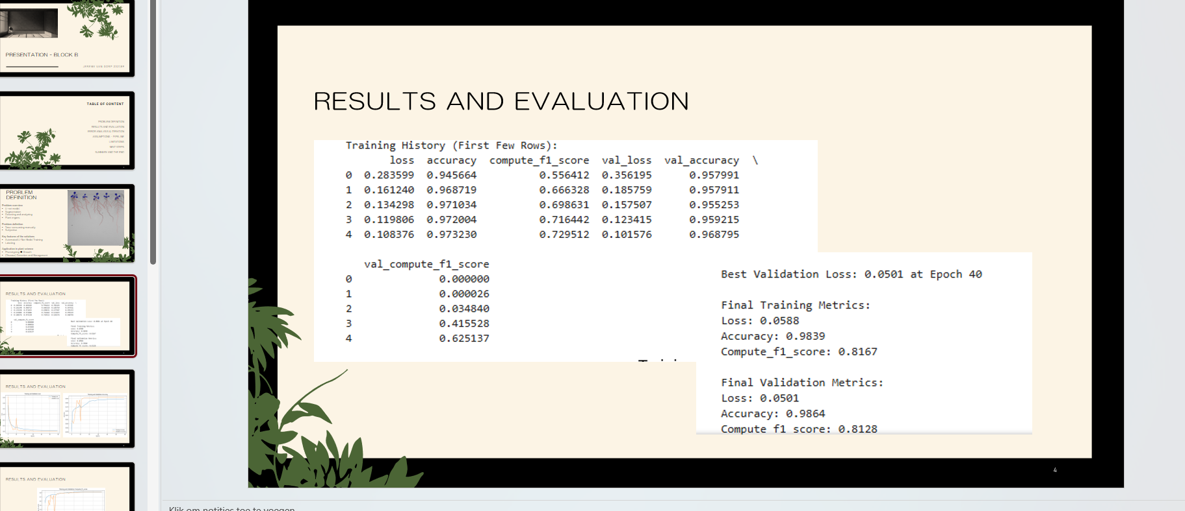
8
Week 8 - Log
1/2
What did you do?
Reflection
What goal(s) did you set for this week?
Evidence and deliver before the deadline.
Make sure that I am on time at school to attend for my presentation.
What have you actually been able to do?
The deadline is in this time being still ongoing.
I attended and did my presentation.
Showcase the evidence of your progress (production artifacts, short descriptions-links-pictures animated gifs, etc.)
How did the week go?
The week was compared with last week pretty good. I had more sleep this week and managed a better balance with school, work, sports and free time.
What went well?
The presentation went alright. I managed to present a good 8,5 minutes.
What didn’t go so well?
No points to add.
What did you learn?
I feel more confident presenting in my second language.
How did your efforts in applying iterative critical thinking this week contribute to improving your approach to the project? (ILO 2.6)
- See next page
What could be added as an Action point looking forward to next week?
- Nothing to add

Slide 32
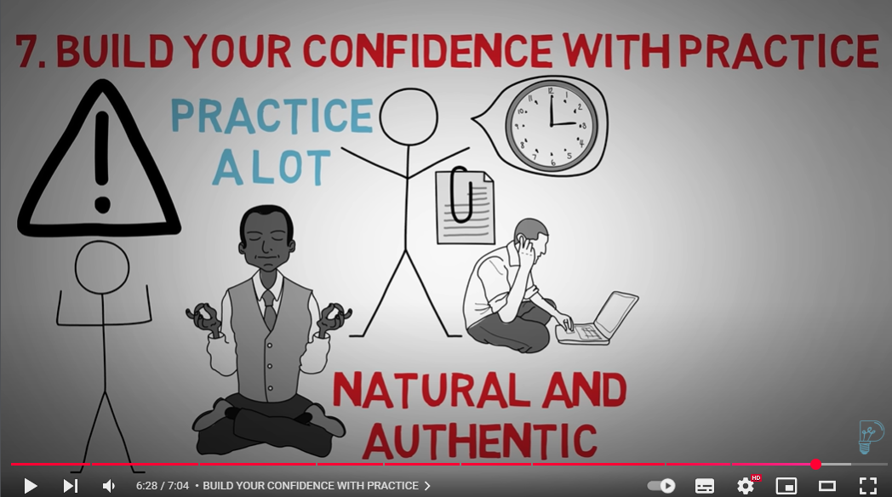
Week 8
How did your efforts in applying iterative critical thinking this week contribute to improving your approach to the project? (ILO 2.6)
My contributions have helped because...
I watched a YouTube video on presentation tips to improve my delivery and use as a reminder during my presentation. The tips on structuring content, using visuals, and building confidence through practice helped me create a more engaging and impactful presentation. By tailoring my content and rehearsing extensively, I felt better prepared and more confident in delivering key points effectively to my audience.
Website: (1037) HOW TO Give a Great Presentation - 7 Presentation Skills and Tips to Leave an Impression - YouTube

Slide 33
8
Week 8 - Feedback
2/2
Team, individual, peer, workshop feedback
232996 Joey van Angelen
Don’t make the presentation too technical, it should be understandable for a plant scientist.
Click for feedback delivery techniques!

Slide 34
Section C
C
Progress
Intended Learning Outcomes
Notes:
MUST BE COMPLETED IN WEEK 8, BUT SHOULD BE UPDATED REGULARLY
This is where you link your evidence to each of the Intended Learning Outcomes of this block.

Slide 35
ILO 1
1
Professional practice
The student can collaborate (internationally) in multidisciplinary teams with different levels of knowledge in the field of data use and applications. They can set up and execute projects in collaboration with stakeholders and team members. They can act as a sounding board in discussions with team members, customers, users and experts. They strive for a good balance between input of their own vision and additional expertise of others. They are able to lead a team.

Slide 36
ILO 1
Professional practice
The student can collaborate (internationally) in multidisciplinary teams with different levels of knowledge in the field of data use and applications.
1/1
1.6
Presentation. The student demonstrates the ability to convert project findings into a coherent and structured presentation. The student is able to communicate the project findings in a professional manner adapted to the audience.
pre-requisites | A: 2 points | B: 2 points | C: 2 points | D: 2 points | E: 2 points
Student submitted a complete learning log, work log and self-assessment rubric. Student presented their findings during the final block presentation. | The student creates well-designed slides where all content is easy to read, and visual elements such as tables, figures, and images are clear and appropriately sized. The student avoids excessive text, ensuring slides are concise and focused. Proper citations are included when needed on individual slides, and each slide has a clear title and is numbered for reference. Plots are presented with properly labeled axes, and images are of suitable resolution for clarity. | The student demonstrates thorough preparation, starts on time, adheres to the time limit, and delivers a well-paced and complete presentation. | The student responds to questions clearly and accurately, demonstrating a solid understanding of the topic and providing thoughtful, well-reasoned answers. | The student delivers the presentation confidently, maintaining eye contact, using clear language, and engaging the audience throughout. | The student organizes the presentation logically, ensuring that the problem, approach, and results are easy to follow and well-explained.
Worklog: https://github.com/JeremyvanGorp232189/2025_B/blob/7803f10b1322ef26ca39e440f8022265395d48c8/Y2B_worklog_24-25_ADSAI%20(1).xlsx Learning log: https://github.com/JeremyvanGorp232189/2025_B/blob/7803f10b1322ef26ca39e440f8022265395d48c8/Y2B_learning_log_24-25_ADSAI%20(1).pptx Self assessment: https://github.com/JeremyvanGorp232189/2025_B/blob/7803f10b1322ef26ca39e440f8022265395d48c8/Y2B_self-assessment-rubric_24-25_ADSAI%20(1).xlsx Presentation slide: https://github.com/JeremyvanGorp232189/2025_B/blob/1e352b998670b1310dd5574652c15112b8fff262/presentation/presentation_block_b.pdf Presentation video: IMG_4802.MOV | I have created well-designed slides with easy-to-read content and clear, appropriately sized visual elements like tables, figures, and images. I have avoided excessive text, keeping the slides concise and focused. Proper citations have been included when needed, and each slide has a clear title and is numbered for reference. I have ensured that plots are presented with properly labeled axes and used high-resolution images to maintain clarity. Presentation slide: https://github.com/JeremyvanGorp232189/2025_B/blob/1e352b998670b1310dd5574652c15112b8fff262/presentation/presentation_block_b.pdf Presentation video: IMG_4802.MOV | I demonstrated thorough preparation, started on time, adhered to the time limit, and delivered a well-paced and complete presentation. My presentation was completed in 8 minutes and 30 seconds, and I maintained a steady and clear pace throughout. Presentation slide: https://github.com/JeremyvanGorp232189/2025_B/blob/1e352b998670b1310dd5574652c15112b8fff262/presentation/presentation_block_b.pdf Presentation video: IMG_4802.MOV | I responded to questions clearly and accurately, demonstrating a solid understanding of the topic. My mentor asked two questions, and I provided thoughtful and well-reasoned answers to both. Presentation slide: https://github.com/JeremyvanGorp232189/2025_B/blob/1e352b998670b1310dd5574652c15112b8fff262/presentation/presentation_block_b.pdf Presentation video: IMG_4802.MOV | I delivered the presentation confidently, maintained eye contact most of the time, used clear language, and engaged the audience throughout. Presentation slide: https://github.com/JeremyvanGorp232189/2025_B/blob/1e352b998670b1310dd5574652c15112b8fff262/presentation/presentation_block_b.pdf Presentation video: IMG_4802.MOV | I organized the presentation logically by following the creative brief structure, ensuring that every necessary detail was included. The problem, approach, and results were easy to follow and well-explained. Presentation slide: https://github.com/JeremyvanGorp232189/2025_B/blob/1e352b998670b1310dd5574652c15112b8fff262/presentation/presentation_block_b.pdf Presentation video: IMG_4802.MOV

Slide 37
ILO 2
2
Personal development & Academic practice
The student applies relevant (research) methods and techniques in combination with relevant and adequate argumentation. They can reflect on (business) processes and their role in them, both theoretically and practically, by constantly evaluating their own actions and adapting them with input from others. They can translate the result of the reflection into concrete personal learning objectives.

Slide 38
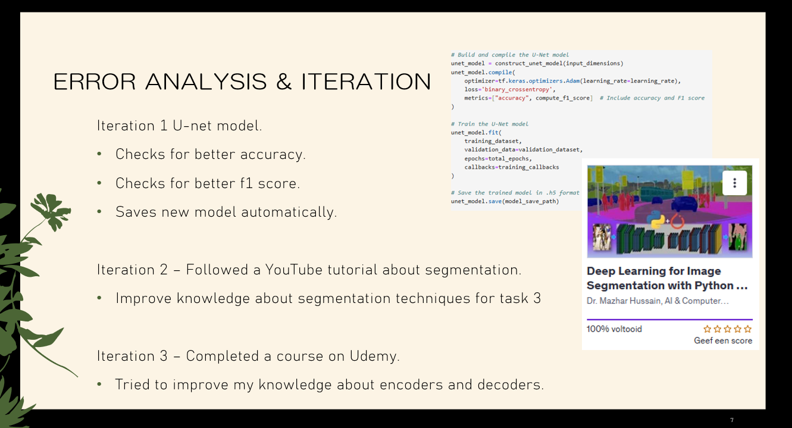
ILO 2
Personal development
The student can reflect on (business) processes and their role in them, both theoretically and practically, by constantly evaluating their own actions and adapting them with input from others. They can translate the result of the reflection into concrete personal learning objectives.
1/1
2.6
Critical Thinking. The student is able to apply critical thinking skills during the block on the project and the learning experience.
pre-requisites | A: 10 points
Student submitted a complete learning log, work log and self-assessment rubric. Student presented their findings during the final block presentation. | The student demonstrates the ability to critically evaluate their approach to solving computer vision tasks by reflecting on daily progress through work log entries and weekly progress through the learning log. This includes error analysis, identifying challenges, identifying edge cases, justifying decisions, listing assumptions and planning next steps to iteratively improve the project. The student consistently applies these reflections to optimize workflow and enhance problem-solving strategies, with the iterative improvement clearly identifiable in the worklog and learning log section B. The student discusses three crucial iterations in the final block presentation in detail.
Worklog: https://github.com/JeremyvanGorp232189/2025_B/blob/7803f10b1322ef26ca39e440f8022265395d48c8/Y2B_worklog_24-25_ADSAI%20(1).xlsx Learning log: https://github.com/JeremyvanGorp232189/2025_B/blob/7803f10b1322ef26ca39e440f8022265395d48c8/Y2B_learning_log_24-25_ADSAI%20(1).pptx Self assessment: https://github.com/JeremyvanGorp232189/2025_B/blob/7803f10b1322ef26ca39e440f8022265395d48c8/Y2B_self-assessment-rubric_24-25_ADSAI%20(1).xlsx Presentation slide: https://github.com/JeremyvanGorp232189/2025_B/blob/1e352b998670b1310dd5574652c15112b8fff262/presentation/presentation_block_b.pdf Presentation video: IMG_4802.MOV | I demonstrated the ability to critically evaluate my approach to solving computer vision tasks by reflecting on eight iterations over the course of the block. In my presentation, I highlighted three key iterations: Iteration 1, where I improved my U-Net model by implementing checks for accuracy and F1 score and automating model saving; Iteration 2, where I enhanced my segmentation knowledge through a YouTube tutorial; and Iteration 3, where I completed a Udemy course to strengthen my understanding of encoders and decoders. Beyond the presentation, I iteratively analyzed plant anatomy and physiology to better understand Petri dish experiments and applied concepts of segmentation to improve root detection techniques. I used Obsidian to organize my self-study notebooks and resolved my PyBullet setup issue by following a video tutorial. These additional iterations further optimized my workflow and improved my problem-solving strategies. U-net model performance of f1-score improved from 0.6 → 0.81 Pybullet issue solved by installing C++ packages Followed a course on Udemy to enhance decoders and encoders. Check slides.

Slide 39
ILO 5
5
Domain Knowledge
Domain Knowledge. The student has such knowledge of and insight into one or more domains that they can function as a discussion partner for experts. They are able to quickly immerse themselves in new domains and associated professional networks.

Slide 40
ILO 5
Domain Knowledge
The student has such knowledge of and insight into one or more domains that they can function as a discussion partner for experts.
1/1
5.1
Domain Knowledge. The student demonstrates a solid understanding of the project domain by accurately describing the client and outlining the problem using appropriate domain-specific terminology.
pre-requisites | A: 10 points
Student submitted a complete learning log, work log and self-assessment rubric. Student presented their findings during the final block presentation. | The student demonstrates a clear understanding of the project domain by accurately describing the client, outlining the problem, and correctly using domain-specific terminology during the presentation and answering questions. This includes articulating the significance of the problem and its broader context, ensuring effective communication of key concepts and objectives.
Worklog: https://github.com/JeremyvanGorp232189/2025_B/blob/7803f10b1322ef26ca39e440f8022265395d48c8/Y2B_worklog_24-25_ADSAI%20(1).xlsx Learning log: https://github.com/JeremyvanGorp232189/2025_B/blob/7803f10b1322ef26ca39e440f8022265395d48c8/Y2B_learning_log_24-25_ADSAI%20(1).pptx Self assessment: https://github.com/JeremyvanGorp232189/2025_B/blob/7803f10b1322ef26ca39e440f8022265395d48c8/Y2B_self-assessment-rubric_24-25_ADSAI%20(1).xlsx Presentation slide: https://github.com/JeremyvanGorp232189/2025_B/blob/1e352b998670b1310dd5574652c15112b8fff262/presentation/presentation_block_b.pdf Presentation video: IMG_4802.MOV | I demonstrated a clear understanding of the project domain by accurately describing the client, outlining the problem, and using the correct domain-specific terminology throughout my presentation and when answering questions. I articulated the significance of the problem and its broader context, ensuring that key concepts and objectives were communicated effectively. My use of the appropriate terminology helped convey a professional and thorough understanding of the project. Presentation slide: https://github.com/JeremyvanGorp232189/2025_B/blob/1e352b998670b1310dd5574652c15112b8fff262/presentation/presentation_block_b.pdf Presentation video: IMG_4802.MOV

Slide 41
ILO 6.4
6
Data Collection and Processing
The student masters (technological) skills to acquire, pre-process, process and manage the necessary data to create value for individuals, organizations and domains.

Slide 42
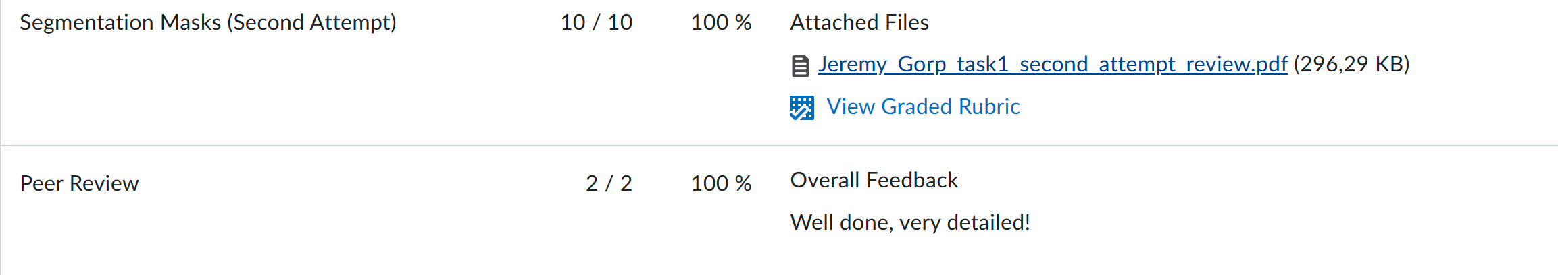
ILO 6
Data Collection and Processing
The student masters (technological) skills to acquire, pre-process, process and manage the necessary data to create value for individuals, organizations and domains.
1/1
6.4
Image Data. The student demonstrates the ability to collect, label, and process image data.
pre-requisites | A: 5 points | B: 3 points | C: 2 points
Student submitted a complete learning log, work log and self-assessment rubric. | The student accurately annotates images for object detection or image segmentation and provides constructive feedback on the quality of peer annotations, in line with client requirements. | The student demonstrates the ability to load, display, and save images, convert between color spaces, and perform basic image manipulations such as resizing, cropping, or rotating. The student demonstrates the ability to perform intermediate image manipulations such as annotating with shapes, overlaying text, and applying masks to isolate regions, in line with client requirements, using industry standard tools. | The student demonstrates the ability to filter images for noise reduction and image enhancement; apply thresholding, edge, and contour detection. The student demonstrates the ability to execute morphological operations on images; combine various traditional computer vision methods effectively to build image segmentation and object detection pipelines without machine learning, in line with client requirements, using industry standard tools.
Worklog: https://github.com/JeremyvanGorp232189/2025_B/blob/7803f10b1322ef26ca39e440f8022265395d48c8/Y2B_worklog_24-25_ADSAI%20(1).xlsx Learning log: https://github.com/JeremyvanGorp232189/2025_B/blob/7803f10b1322ef26ca39e440f8022265395d48c8/Y2B_learning_log_24-25_ADSAI%20(1).pptx Self assessment: https://github.com/JeremyvanGorp232189/2025_B/blob/7803f10b1322ef26ca39e440f8022265395d48c8/Y2B_self-assessment-rubric_24-25_ADSAI%20(1).xlsx Presentation slide: https://github.com/JeremyvanGorp232189/2025_B/blob/1e352b998670b1310dd5574652c15112b8fff262/presentation/presentation_block_b.pdf Presentation video: IMG_4802.MOV | I achieved a 100% score on the peer feedback, accurately annotating images for object detection and image segmentation while providing constructive feedback on the quality of peer annotations, all in line with client requirements. Additionally, I successfully passed the second attempt on plant segmentation, demonstrating my ability to refine my work and meet the expected standards. | I demonstrated the ability to load, display, and save images, convert between color spaces, and perform basic image manipulations such as resizing, cropping, and rotating. Additionally, I performed intermediate image manipulations, including annotating with shapes, overlaying text, and applying masks to isolate specific regions. All tasks were completed in line with client requirements, using industry-standard tools to ensure high-quality results. https://github.com/JeremyvanGorp232189/2025_B/blob/63185129117610d024997e78a45d21ae35f83897/datalab_tasks/task2/task_2.ipynb | I demonstrated the ability to filter images for noise reduction and enhancement, apply thresholding, and perform edge and contour detection. I also executed morphological operations and effectively combined various traditional computer vision methods to build image segmentation and object detection pipelines without machine learning. All tasks were completed in line with client requirements, using industry-standard tools to ensure precision and quality. https://github.com/JeremyvanGorp232189/2025_B/blob/63185129117610d024997e78a45d21ae35f83897/datalab_tasks/task3/task_3_.ipynb

Slide 43
ILO 8
8
Modelling
The student can apply modelling techniques including Machine Learning and AI to create value for individuals, organizations and domains.

Slide 44
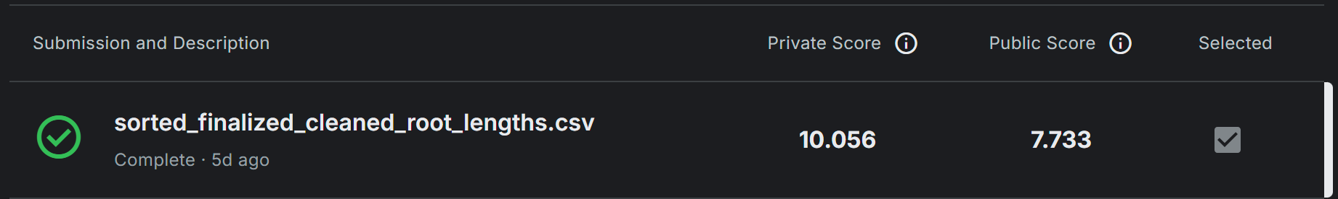
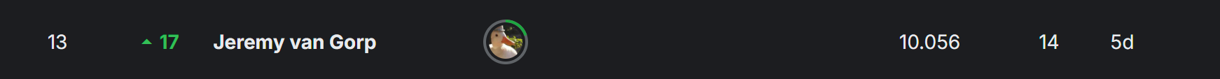
ILO 8
Modelling
The student can apply modelling techniques including Machine Learning and AI to create value for individuals, organizations and domains.
1/3
8.6
Computer Vision. The student demonstrates mastery in programming skills to acquire, pre-process, process, and manage digital images, alongside applying modeling techniques, including traditional computer vision and deep learning methods, to create value across various domains. Furthermore, the student is proficient in developing proof-of-concept solutions through an iterative cycle with explicit stakeholder involvement and can implement applications within existing architectures.
pre-requisites | A: 10 points | B: 20 points
Student submitted a complete learning log, work log, and self-assessment rubric, successfully labeled images as part of the project. Student presented their findings during the final block presentation. | The student demonstrates the ability to design and implement deep learning models for object detection or image segmentation using industry-standard deep learning frameworks, ensuring compatibility between neural network architecture and components in line with client requirements. | The student demonstrates the ability to design and implement end-to-end computer vision pipelines that merge data processing, traditional computer vision, and deep learning; iterate this pipeline towards an optimal solution using techniques such as transfer learning, hyperparameter tuning, data collections. The student demonstrates the ability to extract, process, and analyze quantitative information from images using appropriate algorithms and methods that are in or outside of the computer vision domain. Meanwhile, the student tracks these iterations with industry-standard experiment tracking tools. The student demonstrates the ability to deliver an optimal computer vision solution, in line with client requirements.
Worklog: https://github.com/JeremyvanGorp232189/2025_B/blob/7803f10b1322ef26ca39e440f8022265395d48c8/Y2B_worklog_24-25_ADSAI%20(1).xlsx Learning log: https://github.com/JeremyvanGorp232189/2025_B/blob/7803f10b1322ef26ca39e440f8022265395d48c8/Y2B_learning_log_24-25_ADSAI%20(1).pptx Self assessment: https://github.com/JeremyvanGorp232189/2025_B/blob/7803f10b1322ef26ca39e440f8022265395d48c8/Y2B_self-assessment-rubric_24-25_ADSAI%20(1).xlsx Presentation slide: https://github.com/JeremyvanGorp232189/2025_B/blob/1e352b998670b1310dd5574652c15112b8fff262/presentation/presentation_block_b.pdf Presentation video: IMG_4802.MOV | U-net model ipynb: https://github.com/JeremyvanGorp232189/2025_B/blob/418cea1e5cd9c930acf0bd31b314440769d26035/u_net_model/task_5_training.ipynb U-net model h5: jeremyvangorp_232189_unet_model_patchsizepx.h5 Folders: Task_5 inference: https://github.com/JeremyvanGorp232189/2025_B/blob/5cc16eba283261fdf14823e952c95d2e2f1dbcbb/datalab_tasks/task5/task5_inference.ipynb Predicted mask output: https://github.com/JeremyvanGorp232189/2025_B/blob/5628cda87bba43f7c5ee0ee156a9a6b22eb6eaed/datalab_tasks/task5/task5_test_image_prediction_jeremyvangorp_232189.png | Final Kaggle ipynb: https://github.com/JeremyvanGorp232189/2025_B/blob/63185129117610d024997e78a45d21ae35f83897/kaggle/task_8.ipynb Image slicer py: https://github.com/JeremyvanGorp232189/2025_B/blob/63185129117610d024997e78a45d21ae35f83897/kaggle/task_8_helper.py U-net model ipynb: https://github.com/JeremyvanGorp232189/2025_B/blob/5cc16eba283261fdf14823e952c95d2e2f1dbcbb/u_net_model/task_5_training.ipynb U-net model h5: jeremyvangorp_232189_unet_model_patchsizepx.h5 Folders: Task_5 inference: https://github.com/JeremyvanGorp232189/2025_B/blob/5cc16eba283261fdf14823e952c95d2e2f1dbcbb/datalab_tasks/task5/task5_inference.ipynb Predicted mask output: https://github.com/JeremyvanGorp232189/2025_B/blob/5628cda87bba43f7c5ee0ee156a9a6b22eb6eaed/datalab_tasks/task5/task5_test_image_prediction_jeremyvangorp_232189.png

Slide 45
ILO 8
Modelling
The student can apply modelling techniques including Machine Learning and AI to create value for individuals, organizations and domains.
2/3
8.7
Robotic Control Theory with Computer Vision. The student is able design, implement, and evaluate control algorithms, while implementing computer vision techniques for perception in order to address the business objective.
pre-requisites | A: 2 points | B: 3 points | C: 4 points | D: 3 points | E: 3 points
Student submitted a complete learning log, work log and self-assessment rubric. Clear contribution to this ILO is documented in the learning log. Student presented their findings during the final block presentation. | The student identifies relevant environmental input required for situational awareness. Selects and uses appropriate frameworks for the chosen control algorithm. Instructions for environment setup, including a list of libraries used, are contained in a README.md file on GitHub. | The student demonstrates the ability to set up a robotic simulation environment, send commands to a simulated robot, and receive sensor data for processing and situational awareness. | The student demonstrates the ability to create a controller using traditional control theory. The controller must be able to control a robotic manipulator as described in the creative brief. The controller can use co-ordinates as input. A GIF of the working model is presented on GitHub. | The student demonstrates the ability to integrate a computer vision pipeline into the robotic controller to determine the required co-ordinates according to the requirements in the creative brief. An animation of the working model is presented on GitHub. | The student demonstrates the ability to quanitfy the performance of the model according to appropriate performance criteria. The robot controller can respond to different situational conditions using formal logic. The entire code-base is well documented in a README.md file on GitHub.
Worklog: https://github.com/JeremyvanGorp232189/2025_B/blob/7803f10b1322ef26ca39e440f8022265395d48c8/Y2B_worklog_24-25_ADSAI%20(1).xlsx Learning log: https://github.com/JeremyvanGorp232189/2025_B/blob/7803f10b1322ef26ca39e440f8022265395d48c8/Y2B_learning_log_24-25_ADSAI%20(1).pptx Self assessment: https://github.com/JeremyvanGorp232189/2025_B/blob/7803f10b1322ef26ca39e440f8022265395d48c8/Y2B_self-assessment-rubric_24-25_ADSAI%20(1).xlsx Presentation slide: https://github.com/JeremyvanGorp232189/2025_B/blob/1e352b998670b1310dd5574652c15112b8fff262/presentation/presentation_block_b.pdf Presentation video: IMG_4802.MOV | Not finished | Not finished | Not finished | Not finished | Not finished

Slide 46
ILO 8
Modelling
The student can apply modelling techniques including Machine Learning and AI to create value for individuals, organizations and domains.
3/3
8.8
Reinforcement Learning. The student is able design, implement, and evaluate Reinforcement Learing algorithms in order to address the business objective.
pre-requisites | A: 2 points | B: 3 points | C: 4 points | D: 3 points | E: 3 points
Student submitted a complete learning log, work log and self-assessment rubric. Clear individual contribution to this ILO is documented in the learning log. Student presented their findings during the final block presentation. | The student identifies relevant environmental input required for reinforcement learning. Selects approriate frameworks for the chosen reinforcement learning algorithms. Instructions for environment setup, including a list of libraries used are contained in a README.md file on GitHub. | The student demonstrates the ability to create a custom reinforcement learning gym environment wrapper for the robotic simulation package according to the standard gym framework. The student demonstrates the ability to train a single reinforcement learning model to complete the robotics task described in the creative brief and test it against appropriate performance criteria. The model uses object co-ordinates as input. | The student demonstrates the ability to train and compare the performance of different reinforcement learning models, hyperparameters and reward functions in completing the task successfully. Model hyperparameters are documented in a README.md on GitHub. Performance during the training process as well as the end product is documented on GitHub. | The student demonstrates the ability to complete the task by integrating a computer vision pipeline in the reinforcement learning controller. All inputs used are realistic and appropriate for the task being addressed. The student demonstrates the ability to use an MLOps tool to track the training process and hyperparameter search. | The student trains and tests multiple computer vision reinforcement learning models. Detailed and critical perfomance comparisons are made between reinforcement learning models and traditional control theory. Suggestions for model improvement, real-world implementation, knowledge acquisition and decision-making are made. The entire code-base is well documented in a README.md file on GitHub.
Worklog: https://github.com/JeremyvanGorp232189/2025_B/blob/7803f10b1322ef26ca39e440f8022265395d48c8/Y2B_worklog_24-25_ADSAI%20(1).xlsx Learning log: https://github.com/JeremyvanGorp232189/2025_B/blob/7803f10b1322ef26ca39e440f8022265395d48c8/Y2B_learning_log_24-25_ADSAI%20(1).pptx Self assessment: https://github.com/JeremyvanGorp232189/2025_B/blob/7803f10b1322ef26ca39e440f8022265395d48c8/Y2B_self-assessment-rubric_24-25_ADSAI%20(1).xlsx Presentation slide: https://github.com/JeremyvanGorp232189/2025_B/blob/1e352b998670b1310dd5574652c15112b8fff262/presentation/presentation_block_b.pdf Presentation video: IMG_4802.MOV | Not finished | Wrapper https://github.com/JeremyvanGorp232189/robotics_jeremy/blob/fbddc0fe88bf56201533aff14cc7afe2629cbd62/ot2_gym_wrapper.py Group work: https://github.com/JeremyvanGorp232189/robotics_jeremy/blob/fbddc0fe88bf56201533aff14cc7afe2629cbd62/model%20(1).zip | Not finished Group work: https://github.com/JeremyvanGorp232189/robotics_jeremy/blob/fbddc0fe88bf56201533aff14cc7afe2629cbd62/model%20(1).zip | Not finished | Not finished

Slide 47

Medal Challenges
Going the extra mile!

Slide 48
Medal Challenges
Going the extra mile!
1/1
Put your evidence down here to receive a medal!
Show your best examples, do not go overboard, add in short description, you are free to alter this layout (or add slides per evidence) to suit your needs. Just be sure that it is clear.

Slide 49
Section D
D
Reflection
Notes:
MUST BE COMPLETED IN WEEK 8
Summative reflection on your progress during the block including a critical assessment of everything you did and learned during the block. This is a comprehensive review of everything recorded in Section B, evaluated against the goals and planning laid out in Section A.

Slide 50
D
What did I achieve this block?
1/2
My most significant achievements this block
My most significant achievements this block
I successfully built and optimized a U-Net model for plant root segmentation, achieving improved F1 scores and accuracy. I resolved technical challenges like PyBullet setup issues and refined my workflows for image preprocessing and annotation. Additionally, I delivered a well-structured presentation and received 100% peer feedback on annotations and segmentation tasks.
My most difficult challenges this block
Understanding and implementing advanced segmentation techniques, like thresholding and morphological operations, was challenging. Resolving environment setup issues, such as installing Visual C++ Build Tools for PyBullet, also required significant time and effort. Balancing task deadlines with iterative improvements was another hurdle.
The most important lessons I learned
I learned the value of iteration and critical thinking to refine approaches to complex problems. Effective use of tools like Obsidian and ClearML streamlined my workflow, and building a strong foundation in U-Net and segmentation techniques taught me how to approach real-world challenges systematically.

Slide 51
D
How well am I progressing?
2/2
Reflection on my self assessment My self assessment grade is a
7.0
Reflection on my self-assessment
I feel that I performed well this block, particularly in implementing a U-Net model and refining segmentation techniques. I consistently met deadlines and resolved challenges like environment setup and annotation tasks. However, there is room for improvement in balancing exploration with time management, as I occasionally spent too long on certain iterations without prioritizing progress.
How I plan to improve next block
Next block, I plan to start my work earlier and allocate specific time blocks for experimentation to avoid overcommitting to one task. I will focus on improving my understanding of advanced algorithms and frameworks and seek more peer feedback to validate my approaches. Additionally, I aim to enhance my documentation to streamline communication and track progress more effectively.

